Slide 1
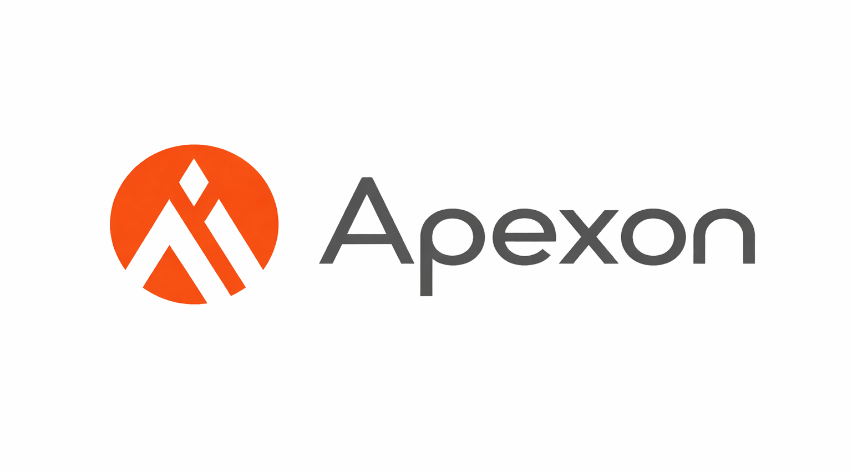
Internship Internal Review
Apexon, Computer engineering

Slide 2
Company Overview
Apexon is a digital engineering services company.
Works on modern technologies including cloud, AI, and full-stack development.
Focuses on innovation and scalable enterprise solutions.
Apexon is a digital-first technology services firm with over 29 years of experience, specializing in digital engineering, data services, and customer experience (CX).
Backed by Goldman Sachs Asset Management and Everstone Capital, the company supports over 5,500 engineers across global offices, focusing on BFSI, healthcare, and life sciences industries.

Slide 3
Role at Company
Digital engineering - Intern
Worked on learning modern technologies and core programming concepts
Focused on strengthening development fundamentals

Slide 4
Goals and Objectives of Internship
Understand real-world software development practices
Learn modern programming languages and tools
Build strong problem-solving and technical skills

Slide 5
Technical Skills Learned
React, Node.js, and Cloud basics
Python programming and OOP concepts
Git, GitHub, and SDLC
Algorithms (BFS, DFS)
Introduction to AI and databases

Slide 6
Week 1 Task
During the first week of my internship at Apexon, I completed onboarding formalities and explored the company environment.
I learned React, Node.js, and cloud basics while revising object-oriented programming.
I also studied data structures such as lists, sets, maps, and arrays, and solved related programming problems.

Slide 7
Week 2 Task
In the second week, I focused on multithreading concepts and understood thread safety.
I gained hands-on knowledge of Git and GitHub for version control. I also studied the Software Development Life Cycle (SDLC) and key software engineering principles used in real-world projects.

Slide 8
Week 3 Task
During the third week, I started learning Python programming from basics to core concepts like classes and objects.
I was introduced to AI-related topics including frontier models and their applications.
I also learned and implemented important graph traversal algorithms such as Breadth-First Search (BFS) and Depth-First Search (DFS).

Slide 9
Week 4 Task
In the fourth week, I continued learning AI and model-related concepts and strengthened my Python skills.
I began learning advanced Python programming concepts to strengthen my coding proficiency. I also worked with numerical and data-processing libraries, which helped me understand number crunching and data handling more effectively.
I worked with data processing concepts and was introduced to SQL, ACID properties, and database operations, enhancing my understanding of real-world data management.

Slide 10
Internship Experience
Great learning experience in a professional environment
Improved technical knowledge and confidence
Understood industry-level development practices

Slide 11
Conclusion
Internship helped bridge academic learning and industry practices
Strengthened programming, tools, and software engineering knowledge
Built a strong foundation for future career growth

Slide 12
Thank You

